Slide 1

Eli Lilly and Company
SET Enhancements Training
December 6th, 2006
ZS Associates
847.492.3600 Tel
www.zsassociates.com

Slide 2
Agenda
Overview 12:00 to 12:15pm
  SET Tool overview
    Role and primary functionality
    Enhancements
Enhancements Overview 12:15 to 1:00pm
  Batch Scenario Creation
  Export Option Changes
Mock Project 1:00 to 2:00pm
  Batch Scenario Creation
  Export Testing

Slide 3
Changes made to the SET Tool create more flexibility for alternate scenario creation and more seamlessly link SET with the ELMO tool
1. Problem Structure Definition
2. KPO Spend-based Scenarios Evaluation
3. Alternate-Possibility Scenario Evaluation
4. Brand Team Meeting Summary Creation
Prepare data
Setup the dimension structure
Enter the estimated brand team KPO baseline spend
Model the long term impact of sales
Estimate the revenue derivation parameters
Define all logistic constraints
Validate entries
Optimize and review Baseline scenario outputs
Refine inputs as necessary
Define alternate KPO spend-base scenarios
Batch validate and optimize scenarios
Review and compare all KPO spend-based scenarios
Specify dynamic constraints (e.g. mix constraints, samples per detail constraint)
Create any incremental spend bound scenarios
Batch Scenario Creation (on activity and spend)
Batch Scenario Output Views (high level, detailed, batch)
Create scenario summaries
Review inputs, key scenario outputs
Address high level revenue implications
Refine and Detailed tabular outputs
Adjustments to parameters
ELMO synchronization with export to MS Access
Batch exports

Slide 4
Agenda
Overview 12:00 to 12:15pm
  SET Tool overview
    Role and primary functionality
    Enhancements
Enhancements Overview 12:15 to 1:00pm
  Batch Scenario Creation
  Export Option Changes
Mock Project 1:00 to 2:00pm
  Batch Scenario Creation
  Export Testing

Slide 5
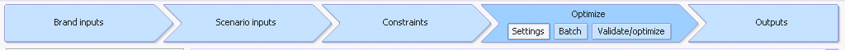
The output section of the tool contains all aggregations resulting from the optimization calculation
View Name | Description of Changes | Metrics
Batch | Create batch scenarios | Batch scenario channels and segments Batch scenario creation max and min
Validate/Optimize | Validate and Optimize batch scenarios

Slide 6
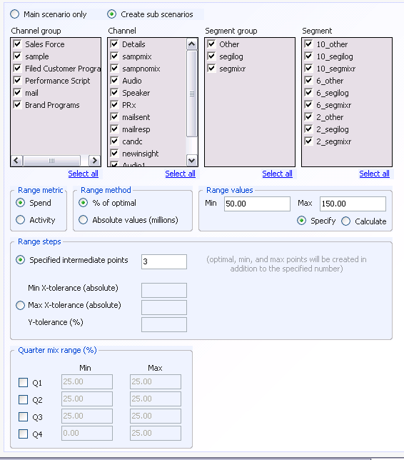
Batch Scenario Creation Page
Choose to turn on the creation of Batch Scenarios
Choose the combination of channels and segments to which constraints will apply
Choose to apply batch constraints on activity or spend
Choose to range spend/activity as a %of optimal
User can enter both max and min of Range
Choose to specify or have the tool calculate the range max. The maximum is calculated using previously entered CxSxQ Frequency constraints
Users can enter the number of specified points, or the X-tolerance, Y-tolerance
Choose to enter the number of specified points or any combination of X-tolerance, max and min of Y-tolerance
Users can enter max and min constraints for chosen quarters
Choose the quarters to which constraints will apply

Slide 7
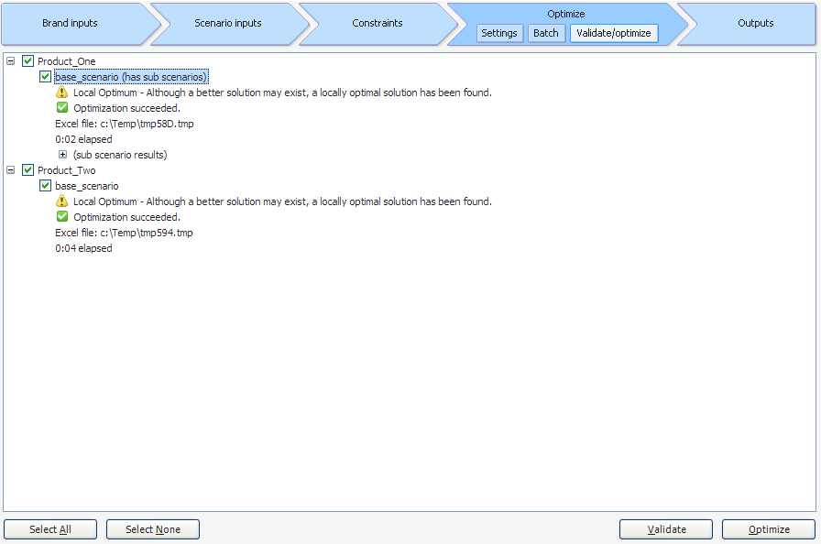
Validate/Optimize Page
The tool notes which base scenarios have batch scenarios
Optimization results from
sub scenarios are automatically
grouped and collapsed.

Slide 8
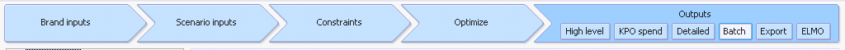
The output section of the tool contains all aggregations resulting from the optimization calculation
View Name | Description of Changes | Metrics
High Level | Display batch scenarios | No metrics changes
KPO Spend | Display batch scenarios | No metrics changes
Detailed | Display batch scenarios | No metrics changes
Batch | Display batch scenarios in tabular and graphical form Export to Excel View Metrics by channel or across channels | 1-year costs, activity, 1-year gross revenue, 1-year net revenue, 3-year discounted gross revenue, 3-year discounted net revenue, 3-year discounted contributions, 3-year NRx, 3-year TRx
Export | Export batch scenarios | No metrics change
ELMO | Selection of export options Export to Access | Details Channel, Samples Channel, Product Inputs, Quarter Inputs

Slide 9
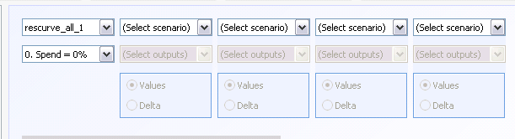
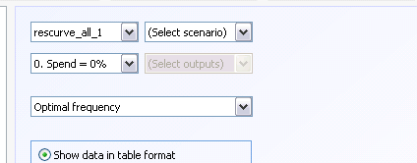
Batch Scenario High Level/ KPOspend Outputs Page
High Level Outputs
Choose which base and sub-scenarios to view from the drop-down menu
KPO Spend / Detailed Outputs
Choose which base and sub-scenarios to view from the drop-down menu

Slide 10
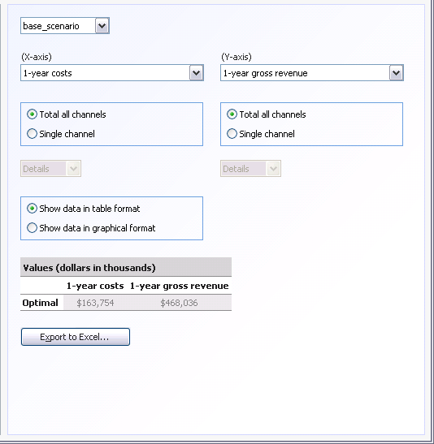
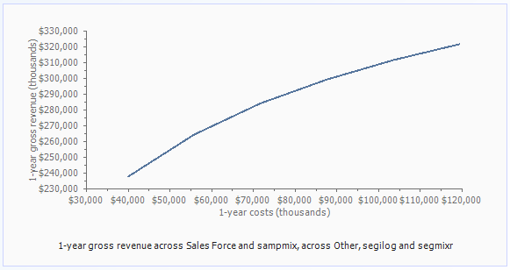
Batch Scenario Outputs Page
Choose the base scenario from the drop-down menu
Choose the X and Y axis of the table or graph from the drop-down menu
Choose to display all channels in the batch scenarios or single channels
Choose the single channel to display
Choose to show the data in tabular or graphical form
Use the button to export to Excel

Slide 11
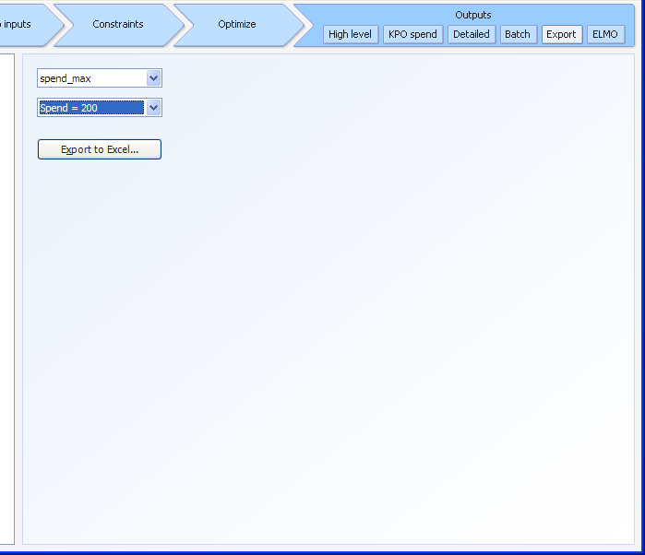
Batch Output Excel Export Page
Choose the base and sub-scenario to export using the drop-down menus
Use the button to export to Excel

Slide 12
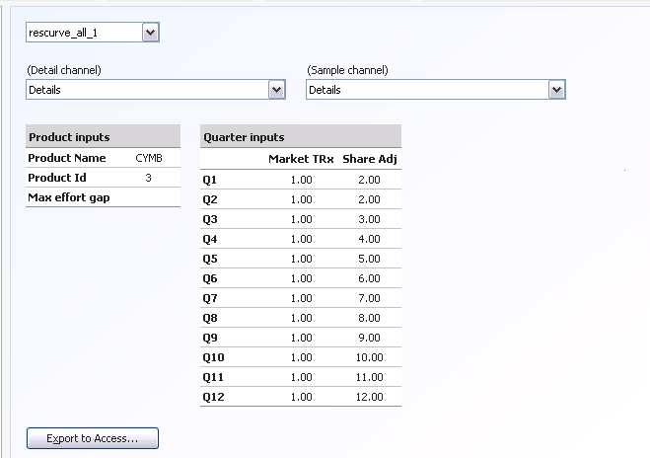
ELMO-ready Export Page
Choose the base scenario using the drop-down menu
Choose the detail channel and sample channel from the drop-down menus
To export to ELMO, batch scenarios must be run with exactly two channels
Enter the Product Name, and Product ID, to be displayed in the outputs
Enter the Max Effort Gap to interpolate points. The number of points is calculated by bisecting the distance between batch scenarios until the change in effort is less than the max effort gap.
Enter Market TRx and Share Adjustment Factors to be used in the export calculations
Use the button to export to Access

Slide 13
Agenda
Overview 12:00 to 12:15pm
  SET Tool overview
    Role and primary functionality
    Enhancements
Enhancements Overview 12:15 to 1:00pm
  Batch Scenario Creation
  Export Option Changes
Mock Project 1:00 to 2:00pm
  Batch Scenario Creation
  Export Testing

Slide 14
Training exercise for batch creation – Product_One
Navigate to the Batch Scenario creation page and choose the Product_One base scenario
Choose the create sub scenarios button
Choose the Details and Sampmix channels, and segments, as appropriate
Create a batch set that varies spend as a % of optimal from 50% to 150%
Allow the model to create the number of scenarios using a max and min X-tolerance of $10 MM, and a Y-tolerance of 30%

Slide 15
Training exercise for batch creation – Product_Two
Choose the Product_Two base scenario
Choose the create sub scenarios button
Choose the Details, Sampmix, and Sampnomix channels
Create a Batch set that varies spend as a % of optimal from 50% to 150%
Specify 4 range points

Slide 16
Training exercise for batch creation – Product_Two (cont.)
Create a copy of the base scenario
Navigate to the Constraints – Activity/Spend Bounds Tab
Remove Min constraints
Optimize

Slide 17
Training exercise for batch creation – Product_Two (cont.)
Optimize the Product_two Base scenario only
Compare the spend allocated for the Detailed and Samples Channels in the Base and 110% of optimal sub-scenario
View the sub-scenarios in graphical form

Slide 18
Training exercise for ELMO exports
Export Product_One to Access using given Product inputs and previously entered Quarter Inputs to the database “Set_Training.mdb”
Adjust Product_Two and export to Access
View exports in Access database
 | Product_One | Product_Two
Product_Name | One | Two
Product_ID | 1 | 2
Max Effort Gap | 10,000 | 50,000

Slide 19
Appendix

Slide 20
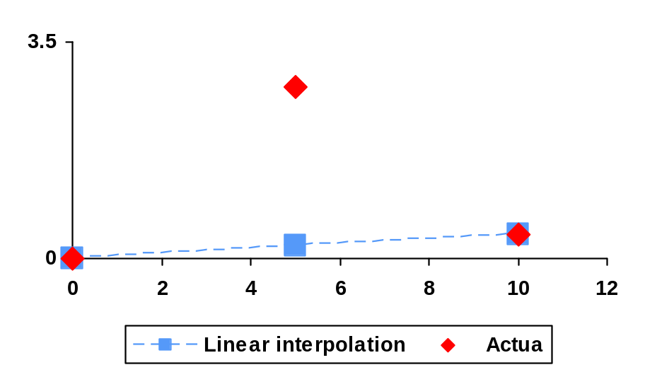
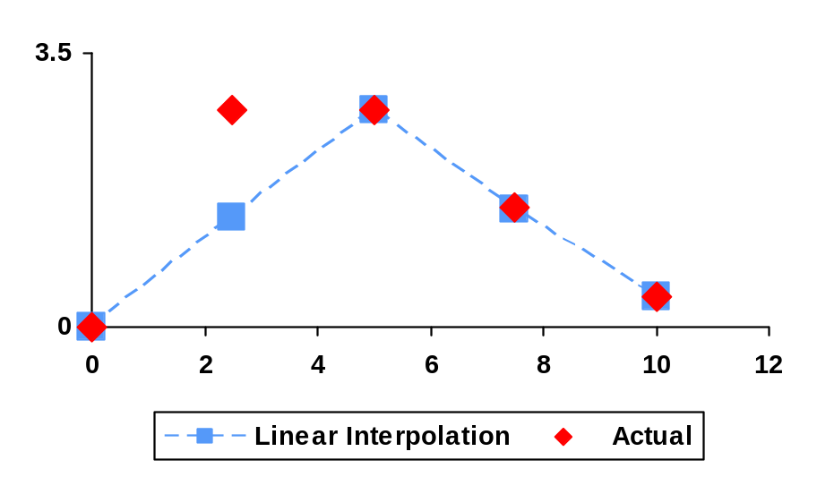
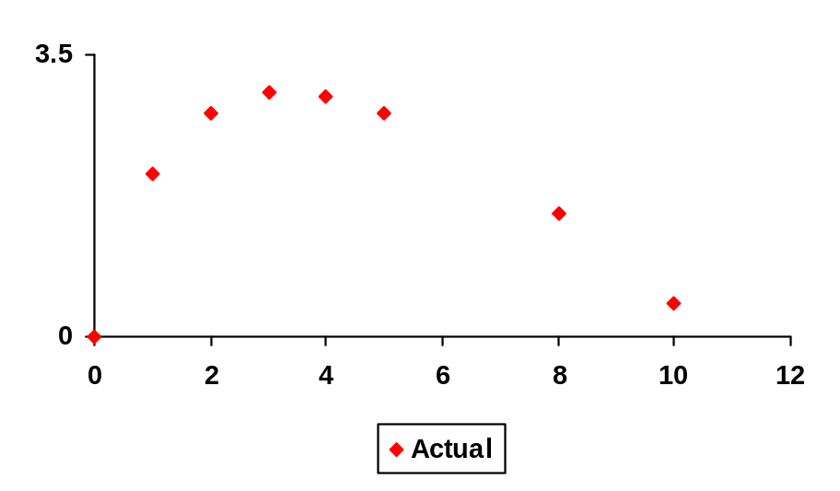
The points along the spend or activity range will be determined based on a tolerance defined on the difference between actual and linear interpolated values
Appendix
1
2
Y-tolerance method illustration
Y-error >
tolerance
Y-error > tolerance
Y-error < tolerance
final
….

Slide 21
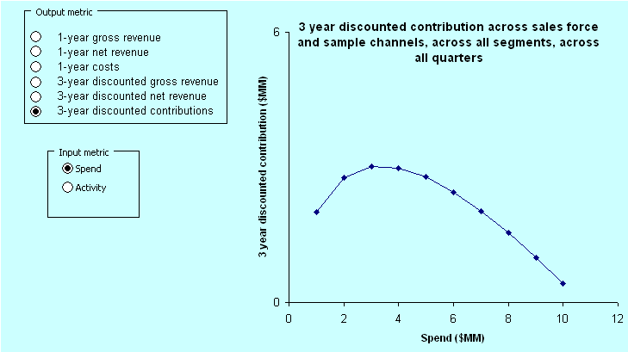
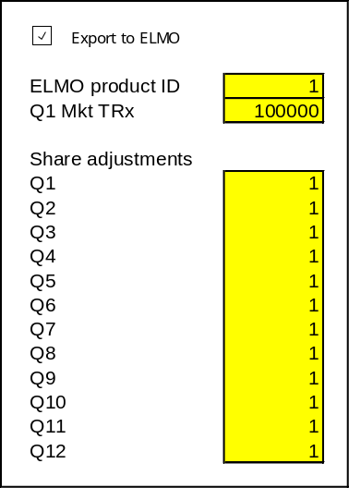
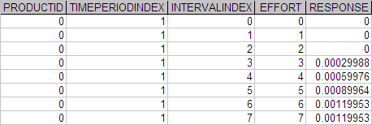
ELMO promotion response table creation
Approach
Need to specify the following parameters within sub-scenario
For qtr=Q1 to Q4
(detTRx(q)+smpTRx(q))/(mkttrx(q1)*shradj(q)
For qtr=Q5 to Q12
Shr_response(q1-q4)*shradj(q)
For Q1-Q4, this would be details per quarter from the sub-scenario curve
For Q5-Q12, the same x-axis can be used as for Q1-Q4
From the specification in SET
subscenario
From the specification in SET subscenario
Period goes from 1 to 12
Notes:
Input ELMO product id
Input Market TRx for all 12 quarters and export this data into Access file
Q5 3 year incremental share based on Q1 and user specified share adjustment
Q6 3 year incremental share based on Q2 and user specified share adjustment
Q7 based on Q3, Q8-Q4
Q9-Q1, Q10-Q2, Q11-Q3, Q12-Q4
Effort = Details component only
Response = 3 year Product TRx due to details and samples from effort in 1 quarter/Market TRx in quarter
Interpolation of y-values to have equal intervals of x-values

